Slide 1
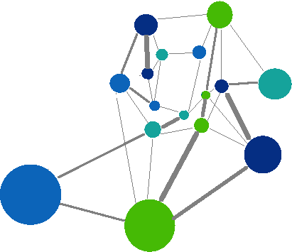
Social Structure and Rank Predict Fitness in
Spotted Hyenas
Conrad Beckmann, Judy Bloom, Jacob Lambert, Rachael Ward, Amiyaal Ilany, and Jiang Jiang
Notes:
Rachael

Slide 2
Outline
Social Structure
Social Network Analysis
Study Species - Hyenas
Matrilineal and Rank Calculations
Network Connectivity
Matrilineal Fitness
Model
Conclusion and Future Work
Notes:
Rachael

Slide 3
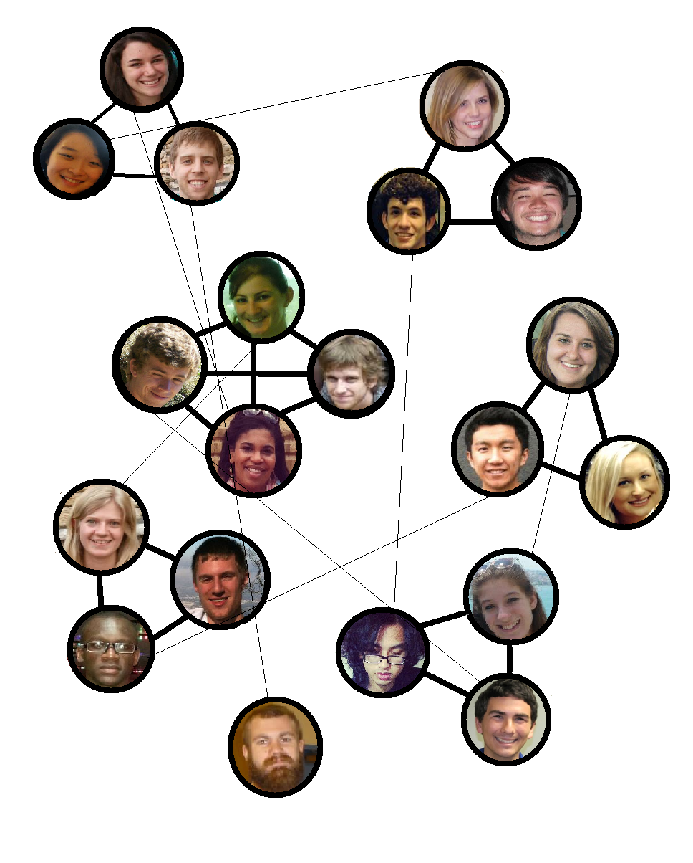
Social Structure
Patterns of interactions
Individuals differ in their importance
Connections influence dynamics in other contexts
May be organized into subgroups
Notes:
Rachael

Slide 4
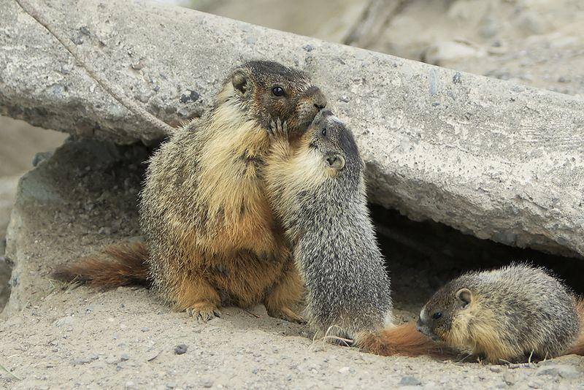
Animal Sociality
“I believe they can tell us a lot about our own society. Animal sociality is similar to ours, while simpler to objectively quantify.”
- Amiyaal Ilany
Notes:
Rachael

Slide 5
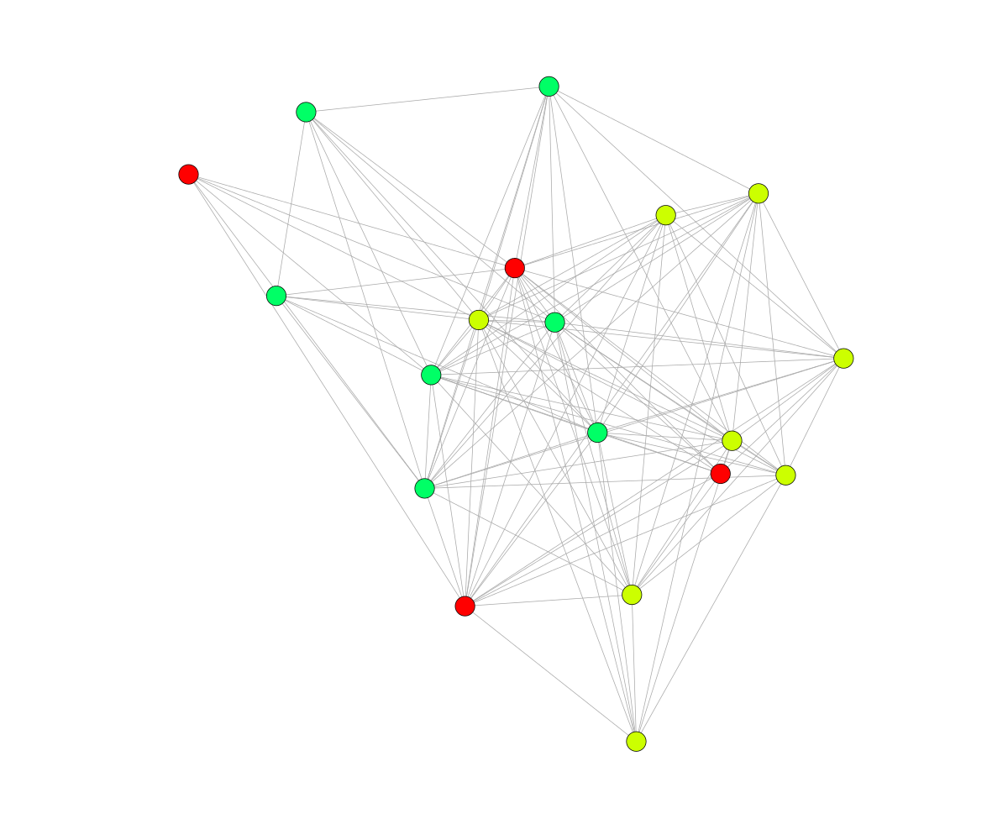
Social Network Analysis
Study of social groups as networks composed of nodes connected by edges
Nodes represent individuals
Edges represent social ties
Notes:
Judy

Slide 6
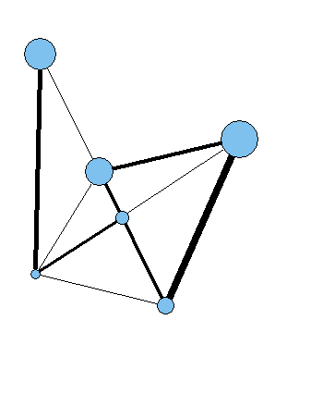
Individual Traits
Independent of network structure
Sex
Age
Social Rank
Notes:
Judy

Slide 7
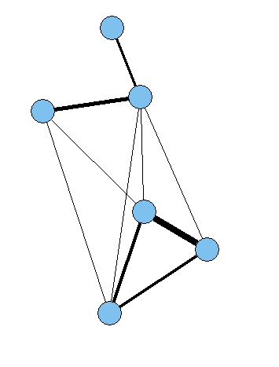
Network Traits
Emerged from network structure
Degree
Triads
Strength of connection in a weighted network
Information Exchange
Benefit
Notes:
Judy

Slide 8
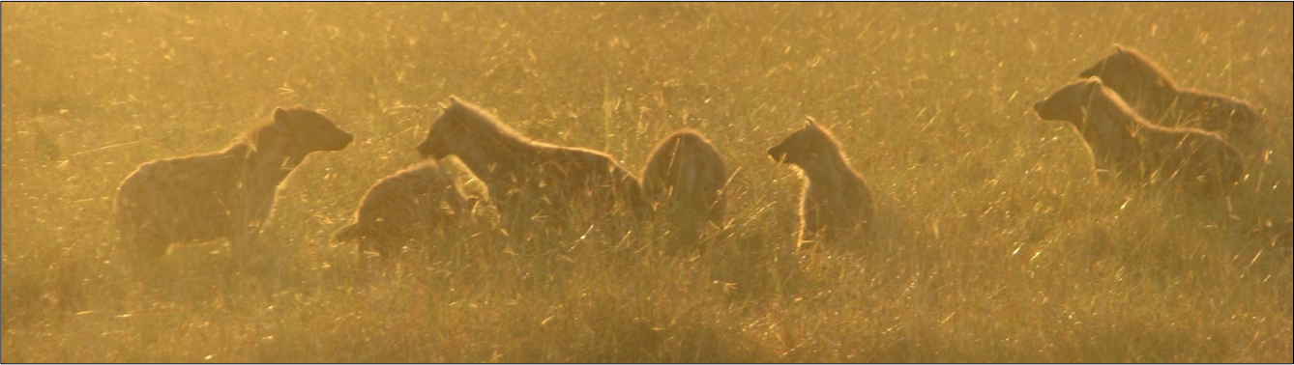
Spotted Hyenas as a Study Species
Social structure is unique among carnivores
Live in multi-family clans dominated by females
Social network divided into family subgroups
Subgroups have distinct ranks
Family groups are determined by maternity
Notes:
Judy

Slide 9
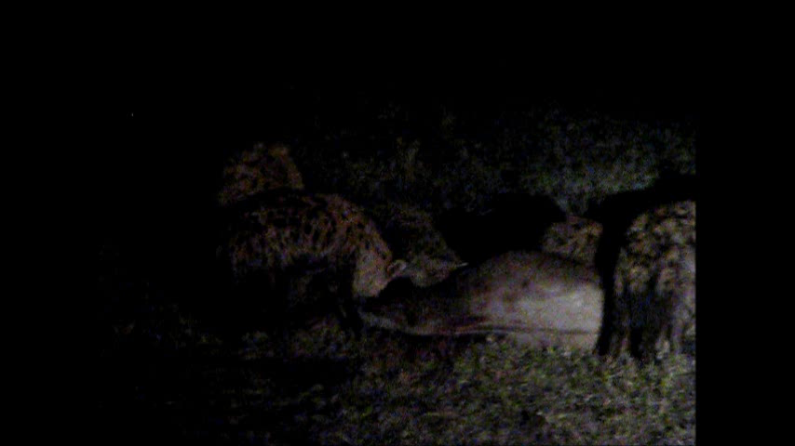
Matrilines and Social Rank
Cubs inherit social rank from mothers
Matrilines share the same rank
Higher rank leads to higher fitness
Better access to resources, able to have more cubs
Notes:
Judy

Slide 10
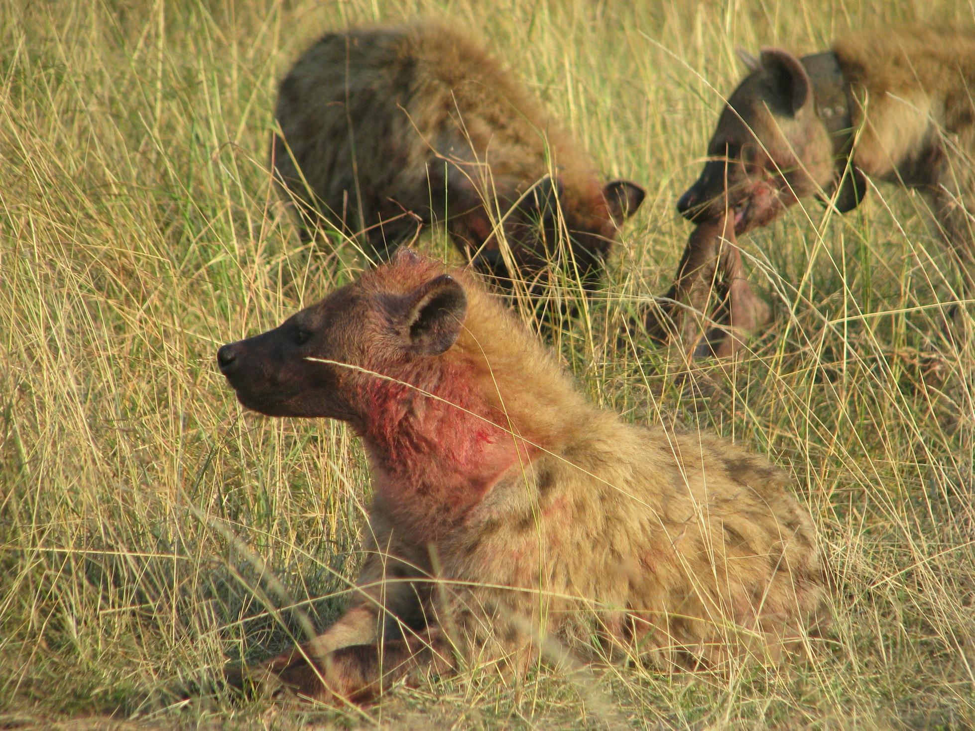
Hypothesis
Rank and connectivity predict fitness better than rank alone
Social connectivity between and within matrilines is what previous studies have attributed to “chance”
Notes:
Conrad

Slide 11
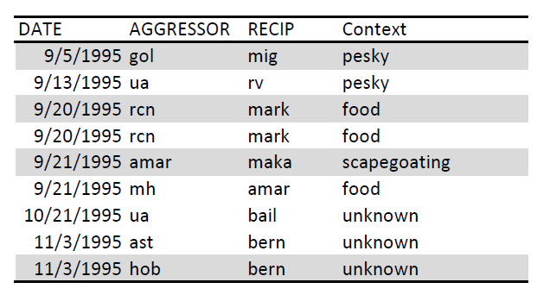
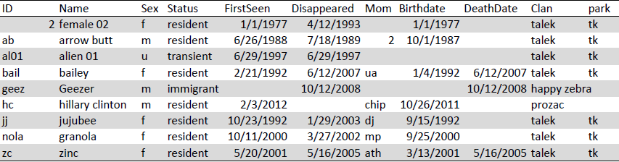
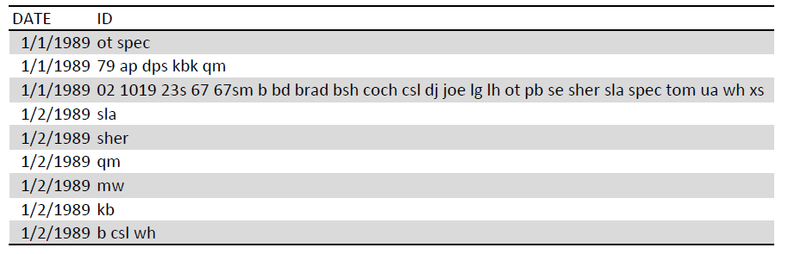
Data
tblAggression: 50,000 aggressive observations
Masai Mara National Park, Talek clan
22 year study 1988 - 2009
tblHyenas: profile data on 2,000 hyenas
tblSessions: 80,000 interactive observations
Notes:
Conrad

Slide 12
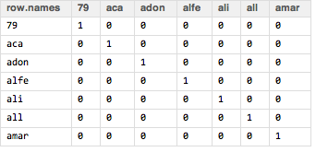
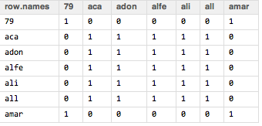
Matriline Detection
Mother-cub relationships determined from Hyena Table
Floyd-Warshall algorithm used to calculate transitive closure
Notes:
Jacob

Slide 13
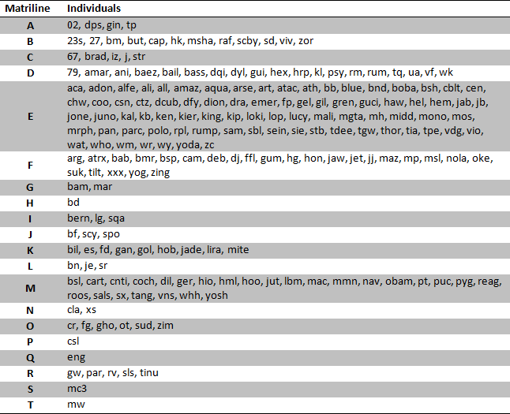
Notes:
Jacob

Slide 14
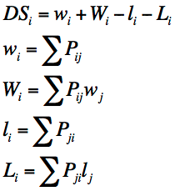
Rank Calculations
David’s Score calculated for every matriline and year
Aggressive interactions used to determine rank
Ignored aggression within matrilines
P_{ij} is the number of instances of aggression of hyenas in matriline i against hyenas in matriline j divided by the total number of instance of aggression between the matrilines
Notes:
Conrad

Slide 15
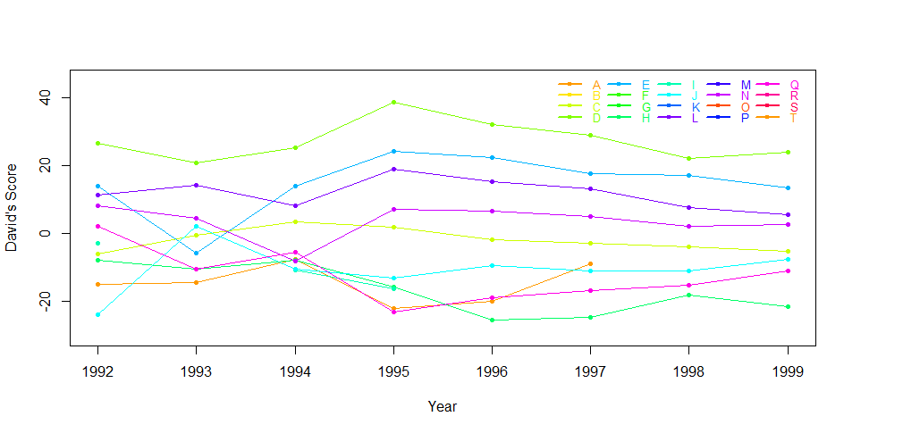
Matriline Rank by Year
Matrilines change ranks over time
Some matrilines die out
Higher ranks are more stable than lower ranks
Notes:
Conrad

Slide 16
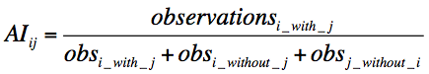
Twice-Weight Association Index
measures connectivity between individuals i and j from observation counts
weights social ties in a weighted network
represented by edge width
Notes:
Jacob

Slide 17
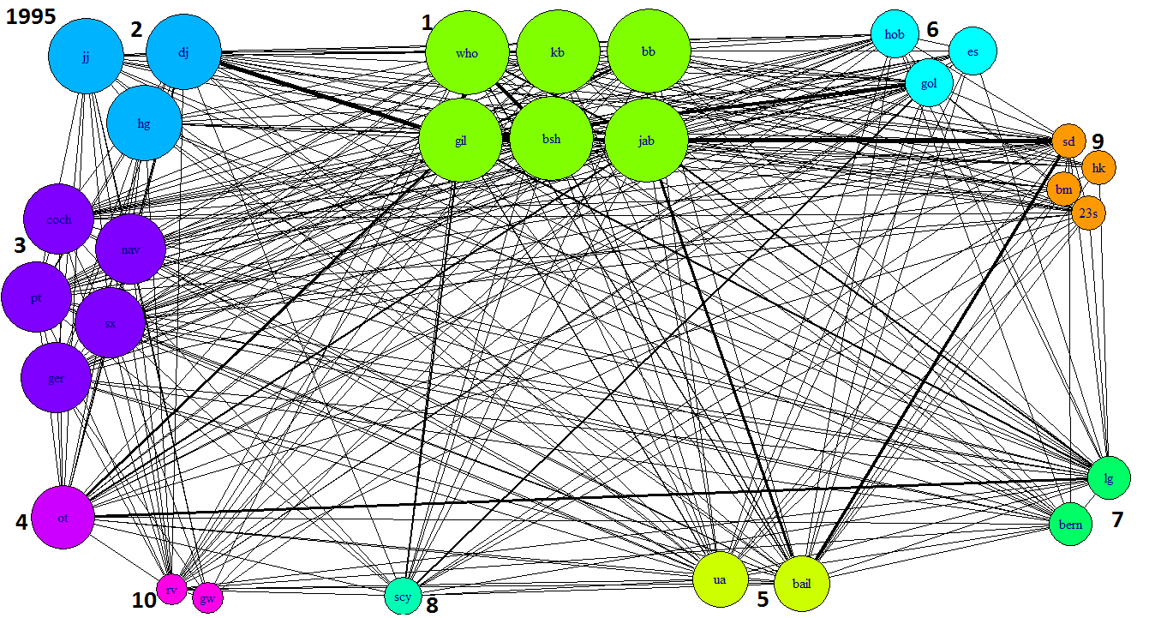
Talek clan social network, 1995
Notes:
Jacob

Slide 18
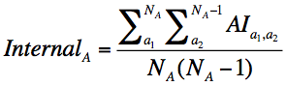
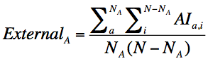
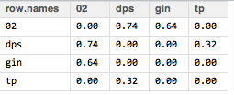
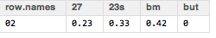
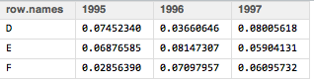
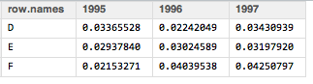
Internal and External Connectivity
Internal Calculations
External Calculations
Notes:
Jacob

Slide 19
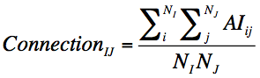
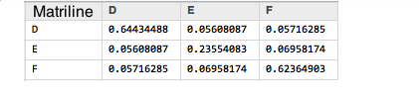
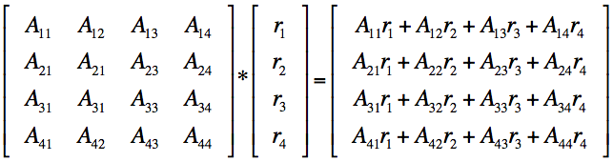
Rank-Weighted Connectivity
Matrix quantifying the connectivity between every pair of matrilines
When multiplied by a rank vector, returns a vector of effects of other matrilines’ social rank weighted by their connection on each matriline
Notes:
Conrad

Slide 20
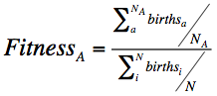
Matriline Fitness
Divided by matriline size to avoid bias towards larger matrilines
Divided by clan average to avoid bias for years with environmental effects that supported more births
Notes:
Conrad

Slide 21
Models
f = f(r, e, i, Ar)
f = fitness
r = rank
e = external connectivity
i = internal connectivity
Ar = rank-weighted connectivity
lm() = function for calculating linear regression models
AIC() = Generic function calculating Akaike's Information Criterion. Lower values indicate a better model.
We tested over 30 models with different permutations of the parameters and compared AIC values.
Notes:
Jacob

Slide 22
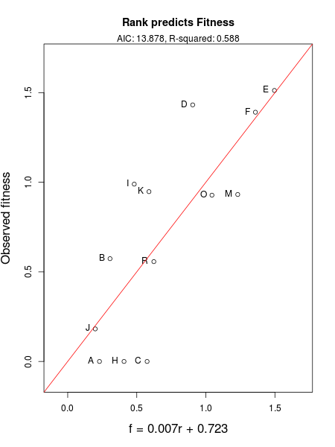
lm(f ~ r)
AIC: 13.84
Access to resources
Larger body size
Notes:
Jacob

Slide 23
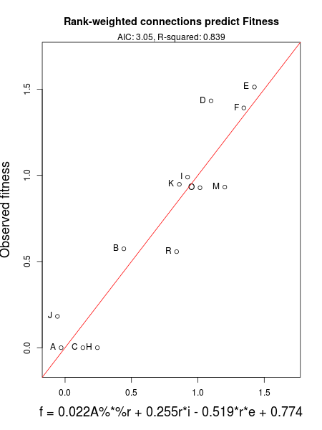
lm(f ~ A%*%r + r:i + r:e) AIC: 3.05
+Connectivity Matrix
Connection with high-ranking hyenas
+Internal Connectivity
Defense against revolutionary coalitions
Control of kills
-External Connectivity
Formation of revolutionary coalitions
Roaming for prey
Notes:
Jacob

Slide 24
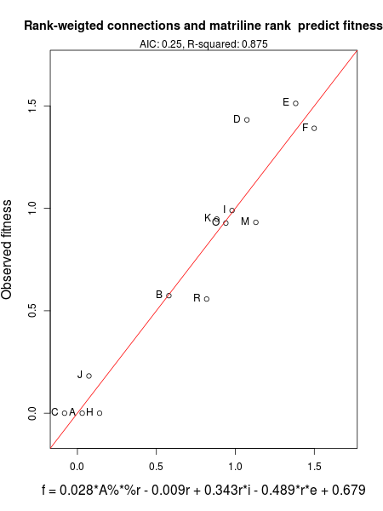
lm(f ~ A%*%r + r + r:i + r:e)
AIC: 0.254
Lowest AIC, highest R² value
Similar parameters as Plot 2
Negative effect of rank (p-value = 0.096)
Counterbalance the connectivity:rank parameters
Notes:
Jacob

Slide 25


Results
Linear models involving rank and connectivity predict fitness better than rank alone
Connectivity within and between matrilines affects differently ranked matrilines differently
Notes:
Conrad

Slide 26
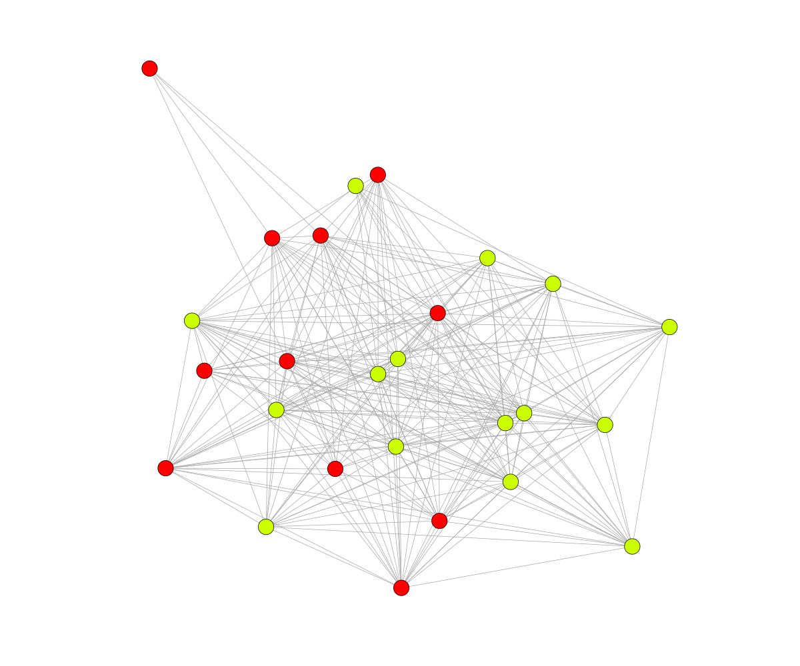
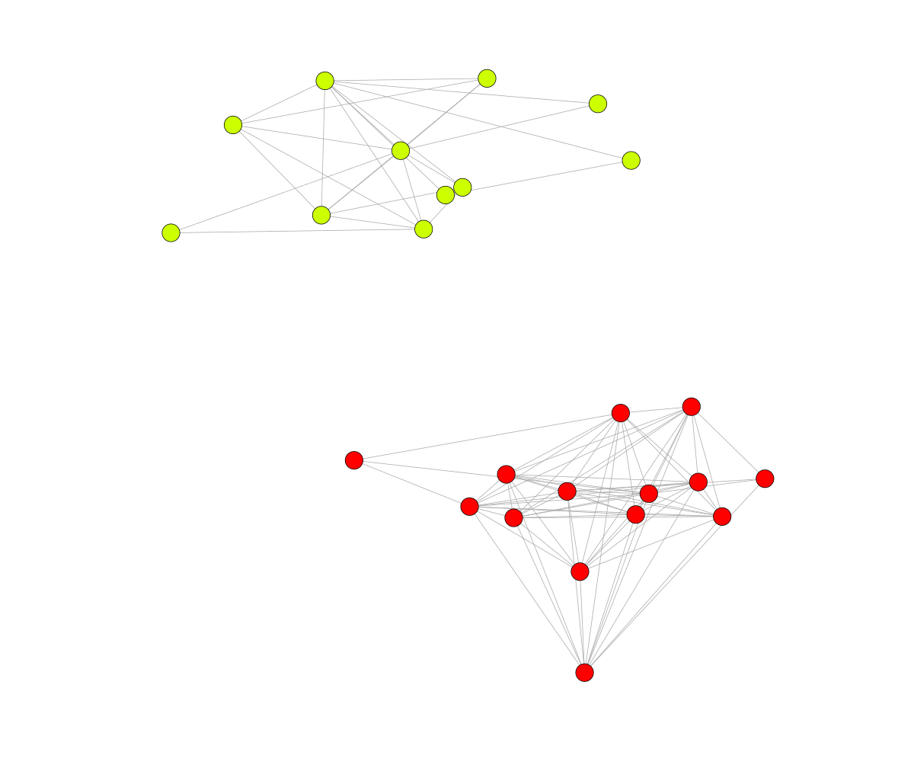
Clan split
Human influence
1999
2005
Notes:
Judy

Slide 27
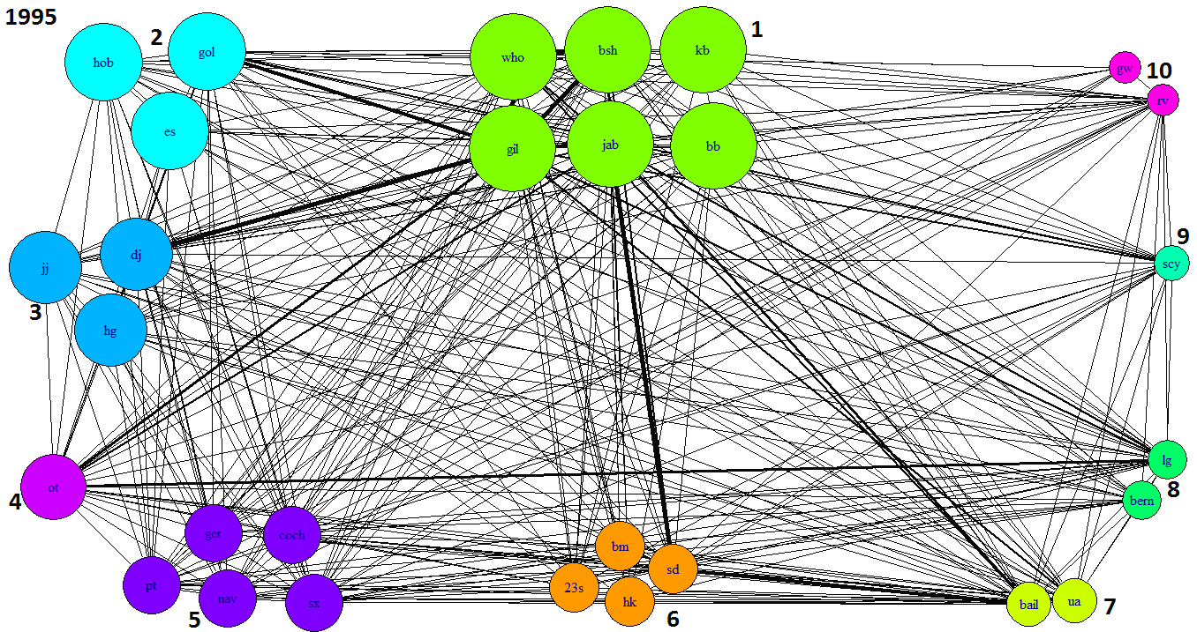

Clan Split
Notes:
Talk about clan split, Judy

Slide 28
Time Interval of Model Variables
Use yearly intervals in the model instead of averaging yearly values over the entire interval 1992-1999
Use more biologically relevant intervals than calendar years
Notes:
Judy

Slide 29
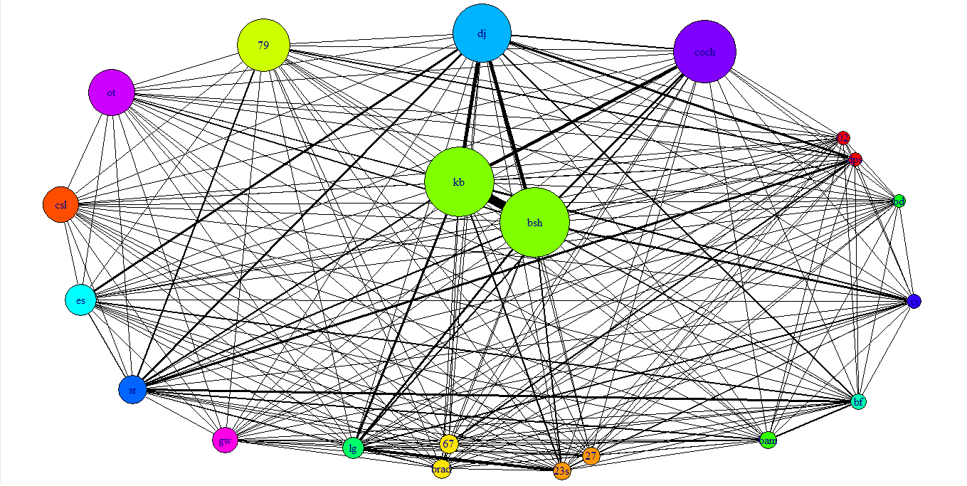
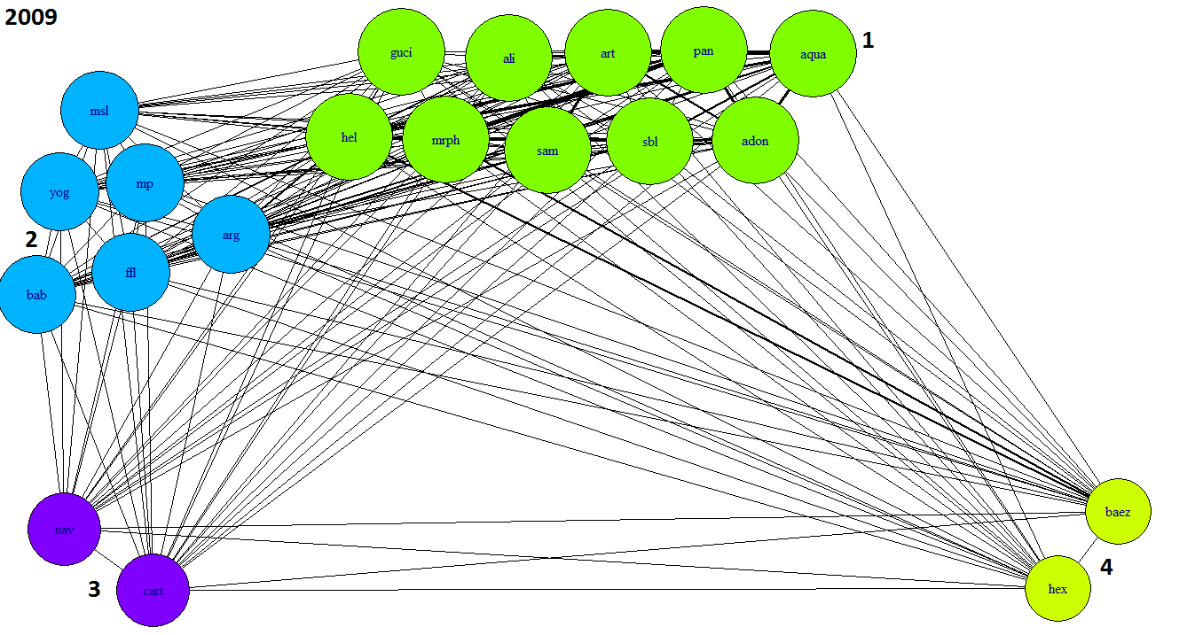
Matriline Determination
Matrilines based on maternal data extending only as far back as mid-1988
Generational gap not considered in later years
Future work: Use divergence of family trees for a more logical and dynamic definition of matrilines
Notes:
Judy

Slide 30
Acknowledgements
We thank NIMBioS for this research opportunity and Dr. Kay Holekamp for allowing us to use the data collected from her lab.
We especially thank Dr. Amiyaal Ilany and Dr. Jiang Jiang for their wonderful mentoring and support throughout the project.
Notes:
Rachael

Slide 31
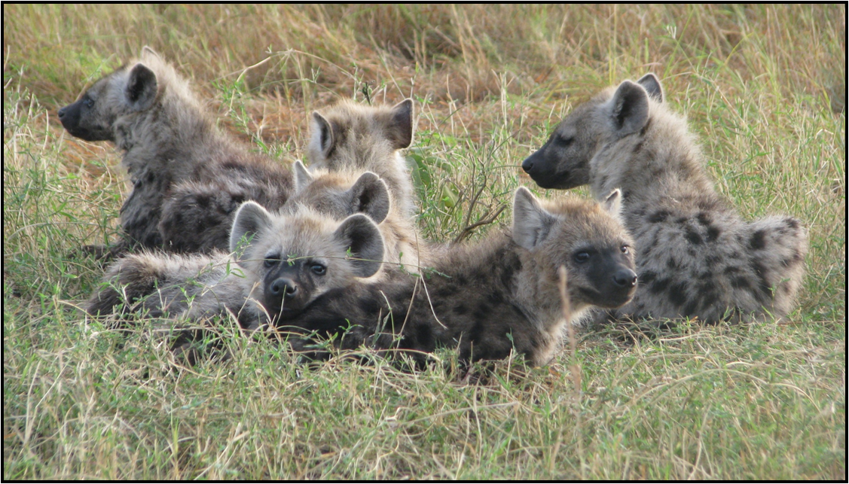
Questions?
Notes:
Rachael

